Slide 1


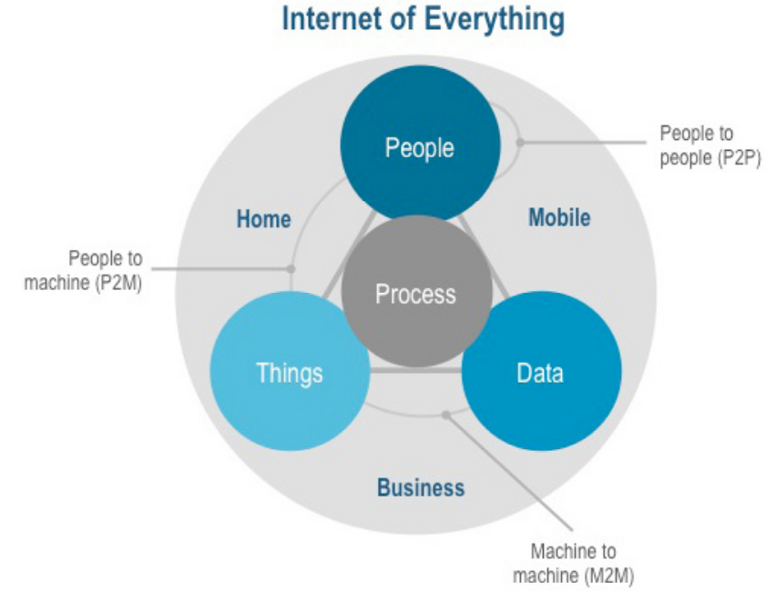
Warm up
Learn-it-all
Internet of Things (IoT)
Even more (from Cisco)
how each of these entities — people, data, and things — works with the others to deliver value in the connected world
Rather than just raw data, connected things will become smart and send higher-level information
physical items
Notes:
back to machines, computers, and people for further evaluation and decision making

Slide 2

Secure COnnected Trustable Things
Toktam Ramezanifarkhani
(IFI UiO)

Slide 3
Agenda
Introduction
Connecting Trustable Things in different domains
BUILDING & HOME / SMART INFRASTRUCTURE
HEALTH
Objectives in Technology Lines
Security & Safety
Results & expected impact
Relevant projects and partners, and our team

Slide 4
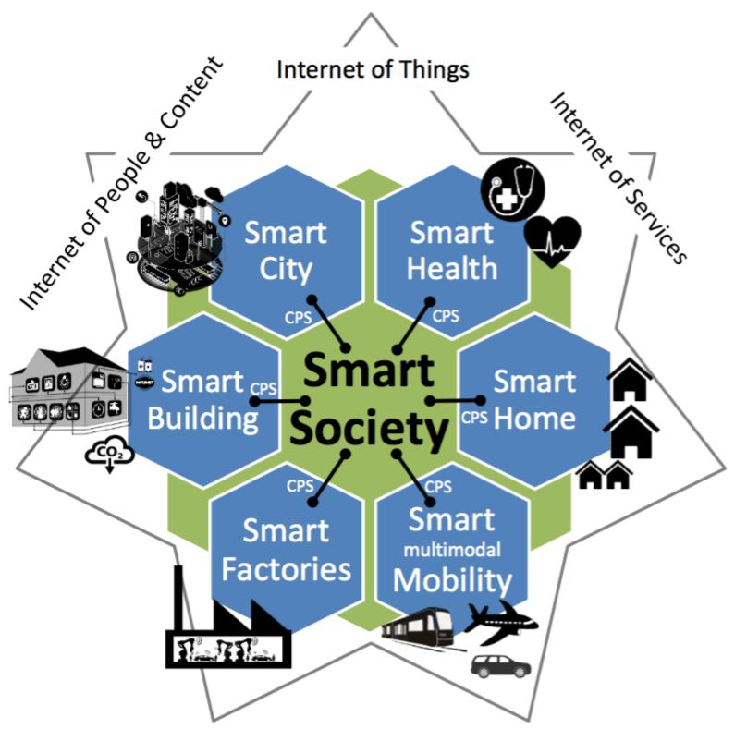
Introduction
A smart society from a technological perspective, needs:
a strong, secure, and scalable communication infrastructure
capable of connecting all relevant entities (smart objects, people, and systems)
in real-time to enable powerful services,
benefiting the society and the human beings

Slide 5
Introduction (2)
Communication between IoT Devices
Wired
Wireless technologies (3G, 4G, 5G, WLAN, IEEE 802.15.x...) with major benefits:
flexibility, mobility, weight reduction, adaptability with changes
‘smart, connected products’
will not only transform data, enterprises and competition,
new industrial scenarios and innovations in a highly networked digital economy
facing a digitalization of business processes
change the communication, business models, and thus attack models
Notes:
[5/5/17, 5:28:14 PM] Peyman Teymoori: Wired is more secure because the medium is not broadcast[5/5/17, 5:29:05 PM] Peyman Teymoori: It's like having one more layer of isolation/security[5/5/17, 5:29:51 PM] Peyman Teymoori: And wired nodes cannot see what the others send[5/5/17, 5:30:39 PM] Peyman Teymoori: In Case of ad hoc networks, you even cannot trust routers

Slide 6
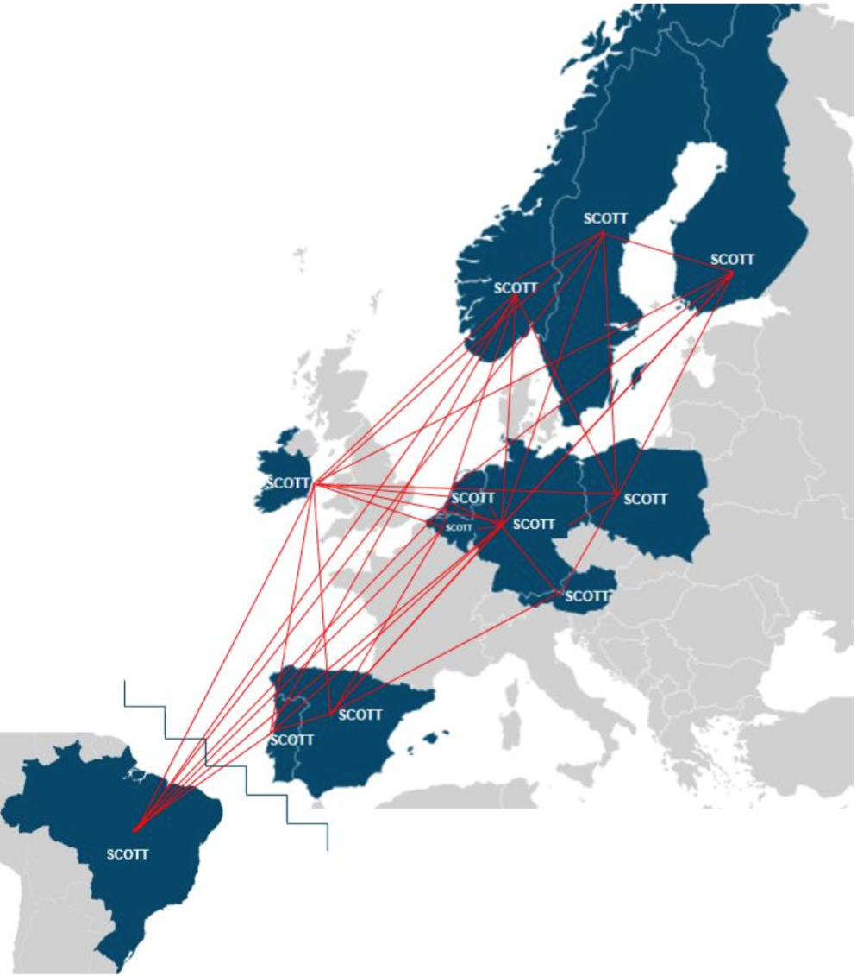
SCOTT - A pan-European effort for trustable wireless solutions
Creating trust in wireless solutions and increasing their social acceptance is one of the major challenges to bring out the full potential of the Internet of Things
Involved partners:
Movation AS
Philips Lighting B.V
Universidad Politecnica de
Madrid
57 key partners from 12 countries (EU and Brazil)

Slide 7
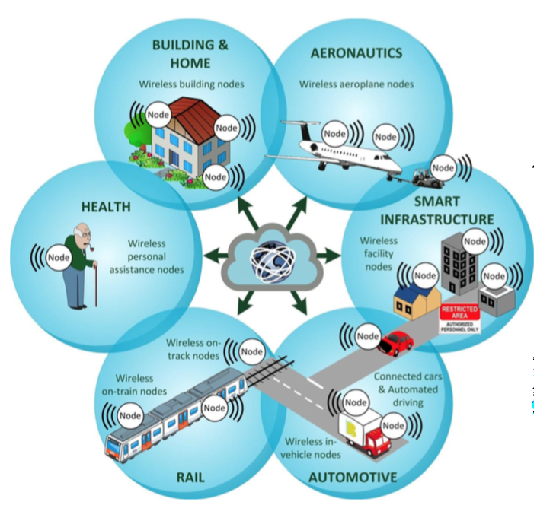
Connecting Trustable Things in different domains with SCOTT
With 3 main objectives:
foster the European leadership for Smart and Connected Things
strengthen Europe’s independence for security enabling components and systems
strengthen Europe’s position in the emerging technology field of secure IoT

Slide 8
Focus on wirelessly connected “things” in domains
Considering integration with wired solutions
foster interoperability of wireless systems
making full potential of cross-domain synergies
standardize interaction across boundaries, across industrial domains
secure communication for smart sensors and actuators
use a standardized multi-domain reference architecture framework compliant with the international standard ISO 29182 – Sensor Network Reference Architecture
fostering reusability, scalability, and interoperability
Notes:
providing USB kind of versatility to the wireless world

Slide 9
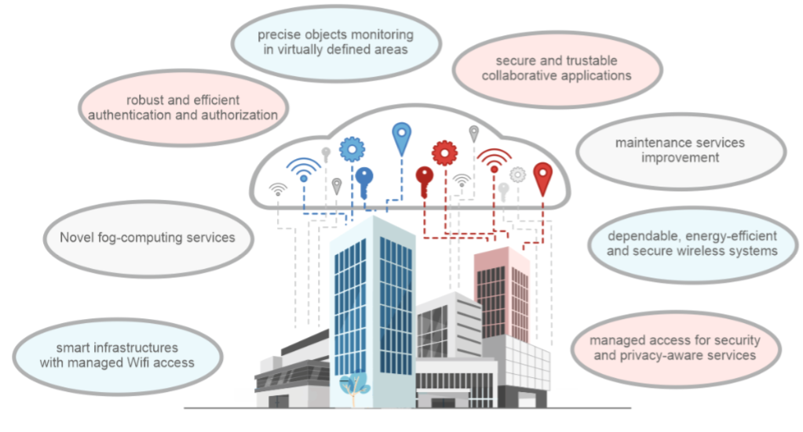
BUILDING & HOME / SMART INFRASTRUCTURE
objects (people, vehicles, tools, equipment etc.) using secure wireless connectivity.
Precise objects monitoring in virtually defined area
Secure and trustable wireless systems and collaborative applications
robustness and efficiency for authentication, authorization, and accounting
provide solutions for AAA for wirelessly communicating embedded systems in environments.
To make cross-connection easily and decrease the added-value to end-users resulted from cross-system application.¹
dependable, energy-efficient and wireless systems
W. Rom et al., "DEWI -- Wirelessly into the Future," Digital System Design (DSD), 2015 Euromicro Conference on, Funchal, 2015
Notes:
authentication, authorization, and accounting

Slide 10
Synergies of Domains

Slide 11
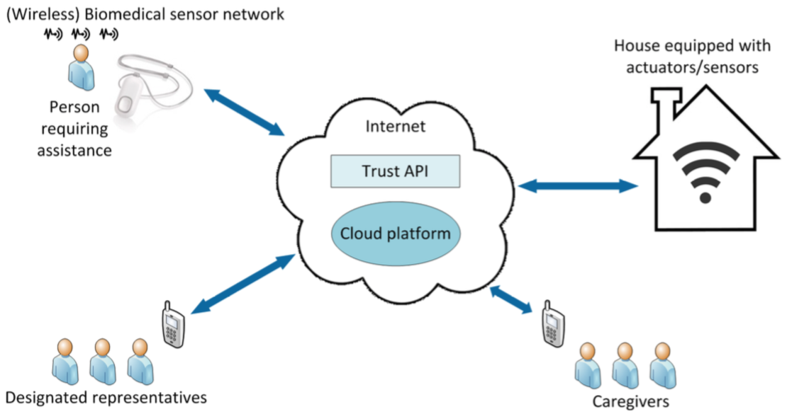
HEALTH
applying advanced wireless sensor technology and Remote:
vital signs to assess personal health, monitoring and controlling it
monitor and control over home
secure geolocation (enables spatial-based authentication to find nearby caregivers)
determining and checking their access to home, and facilities
Notes:
Improved Assisted Living and Community Care by Secure Wireless Biomedical Sensors and Trust Management

Slide 12
Synergies of Domains
12

Slide 13
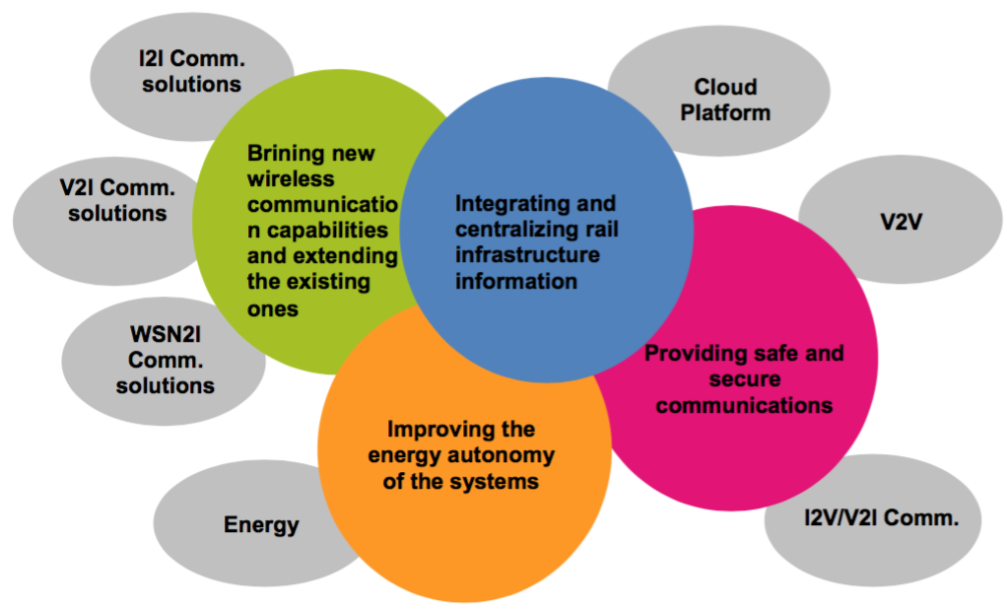
Objectives in the domain of RAIL
… between trains allowing the trustable setting of virtual train convoys.
safe and secure I2V/V2I communication tech. compatible with rail standards to broadcast relevant inf. to different types of vehicles (train, cars) and the infrastructure in a trustable way.

Slide 14
SECURITY & SAFETY
Security and safety have long been two different technical fields
Security: mostly related to either malicious behavior ) or unintentional mistakes
e.g. stealing of computer system data (hacks) when dealing with confidential data.
security has been mostly relevant in the IT world
Safety (in particular “functional safety”): unintentional technical failure of electric/electronic systems
e.g. a break of cables or human errors at design time of a system.
in industrial domains for engineering of machines.
Recently
safe systems got connected to the outside world. Safe systems suddenly became attackable.
E.g. recent hacks of connected cars, fridges, cameras, teddy bears,…

Slide 15
Security, Safety, Privacy and Trustability
targeting trustable simple-to-use security
for both of the professional and private end user
simplifying security and privacy activation and configuration
pave the way via “quantifiable security”
secure information flow in the IoT-driven industry
developing metrics and a framework for “measurable security and privacy”
creating an unprecedented privacy labelling for systems and systems of systems similar to the well-known “energy labelling”
combining safety and security
psychological and socio-contextual enablers for trust formation
Considers social and advanced systems engineering techniques
analyzes, and includes individual and contextual variables to facilitate trust formation in each domain
Notes:
pave the way via “quantifiable security” to a secure information flow in the IoT-driven industry.

Slide 16
Establishing eco-system with re-usable Technical Building Blocks
develop and utilize well-defined reusable Technical Building Blocks for
security/safety,
distributed cloud integration,
energy efficiency and autonomy of devices,
which facilitate composability of systems as well as cross-domain sharing of trustable wireless technologies and services.
SCOTT will build upon the Dependable Embedded Wireless Infrastructure (DEWI)
Communications across many industrial domains has been considered (Bubble),
Now,
makeing the Bubble secure and trustable,
extend the Bubble to the Cloud, enabling new services and applications

Slide 17
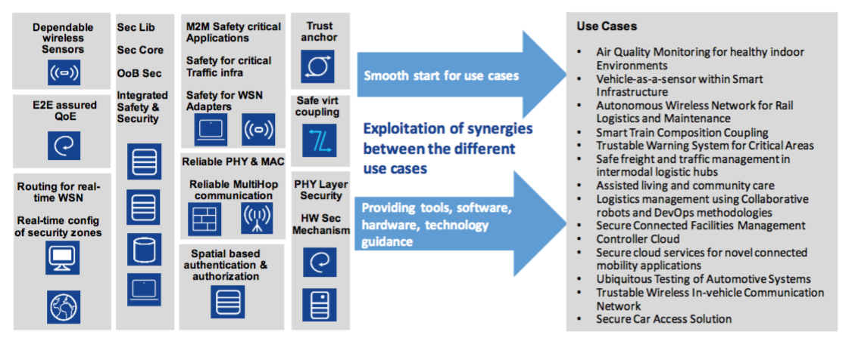
For SECURITY & SAFETY
End-to-End Quality of Experience (QoE): attempts to harmonise the quality expectations of users to the Quality of Service (QoS)
Notes:
Exploitation of synergies between use cases with security and safety building blocks

Slide 18
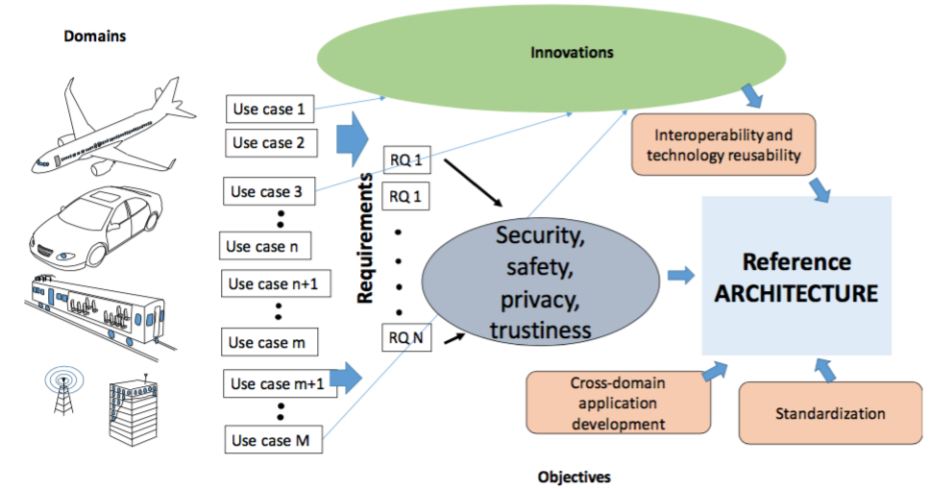


Expected results
SCOTT does not try to find one encompassing solution that fits all, but our objective is to identify key features, req.
Quantify and measurements
Standardization coming from all SCOTT use cases
Communication security tools for IoT devices using various communication protocols (use case dependent)
Secure remote management and access software e.g. for malfunction detection, updates, patches
And of occurs vulnerabilities from programs and firmware's to cross-domains protocols
arbitrary code execution!!!!
Notes:
Intel Active Management Technology (AMT)
HTTP Digest and Kerberos authentication

Slide 19
Other Objectives
attracting 3rd parties and particularly small and medium-sized enterprises (SMEs)
via an Open Innovation Contest
following a use-case driven approach with 15 use cases from different areas of high relevance to European society and industry
SCOTT will put a specific focus on
cross-domain use cases and
heterogeneous environments, emphasizing 5G and cloud.
2G: Wireless went from analog to digital
3G: offered faster data transfer speeds at least 200 kilobits per second
4G: 1 Gigabit per second
5G: speeds of 1-10Gbps
Notes:
Wireless went from analog to digital

Slide 20
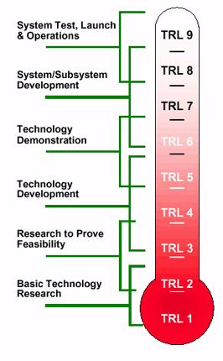
Impact: Higher Technology Readiness Levels (TRLs)
Technology readiness levels (TRL) is a method of estimating technology maturity of Critical Technology Elements (CTE)
How a technology is ready to be used
targeting TRLs up to 6 or 7
Reusing existing solutions and pave their way to the market
not only based on laboratory prototypes
but also testing in operational environment like industry installations (e.g. refinery or automotive testing chambers)
Notes:
of a program during the acquisition process

Slide 21
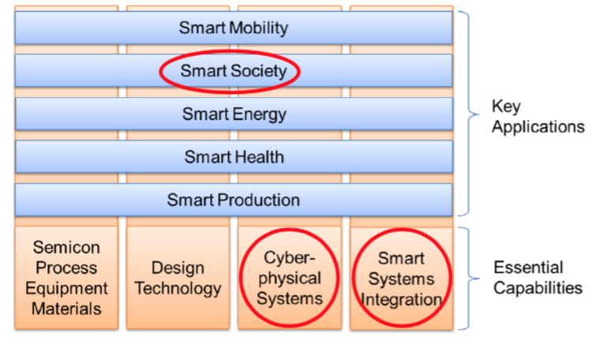
Scope of SCOTT regard to the strategy of ECSEL MASP 2016
In SCOTT
The strategic nature of secure, trustable and connected things
closely matches
Electronic Components and Systems for European Leadership (ECSEL):
a partnership between the private and the public sectors for electronic components and systems
Multi Annual Strategic Research Plan (MASP) 2016

Slide 22
Relevant national or international linkes to the project
DEWI – Dependable Embedded Wireless Infrastructure
March 2014 to February 2017 as part of the ARTEMIS
SCOTT project will build on the excellent basis of the predecessor project DEWI and reuse and extend the well-established DEWI Bubble concept and the related, ISO 29182 compliant multi-domain high-level architecture.
nSHIELD – Measurable Security for embedded Systems
AIOTI – Alliance for Internet of Things Innovation initiated by the European Commission
And about 20 other projects

Slide 23
Our Team for SCOTT
Prof. Josef Noll (josef@jnoll.net)
Leader of the Norwegian SCOTT contribution (SCOTT-NO)
Dr. Toktam Ramezani (toktamr@ifi.uio.no)
COO of (SCOTT-NO)
Dr. Christian Johansen (cristi@ifi.uio.no)
Notes:
Chief Operating Officer

Slide 24
Questions?
toktamr@ifi.uio.no
www.scottproject.eu

